Slide 1
The
Upper Yellowstone Watershed
Key data points on the historical context, land use & economics, groundwater, surface water, climate, and water use
Notes:
https://www.youtube.com/watch?v=eIho2S0ZahI
"Seven deadly sins of speaking to avoid" 1) gossip -> I need to work on this sin 2) judging -> I need to work on this sin 3) negativity -> I need to work on this sin 4) complaining -> I need to work on this sin 5) excuses 6) lying (embroidery, exaggeration) 7) dogmatism (confusion between fact and opinion)
What I need to say: four powerful cornerstones of speech to make a change in the world c.f. "hail means to greet or acclaim enthusiastically" 1) H: honesty (be clear and straight) 2) A: authenticity (be myself) 3) I: integrity (be my word) 4) L: love (wish them well)
how I need to say: tools to play with to increase power of my speech 1) register: e.g. if wanting weight, lower pitch of voice 2) timbre: the way voice feels e.g. breathing, posture 3) prosody: rhythm (e.g. not monotone) 4) pace: e.g. slow to emphasize 5) pitch: e.g. make pitch high or low 6) volume: e.g. louder to emphasize
exercise the following before making a presentation 1) arms up to sigh out with ahh 2) lips with ba ba 3) lips with brrr 4) tongue with la 5) tongue rolling an r 6) siren from we to aww﻿

Slide 2
Landscape & Context
The Place & People

Slide 3
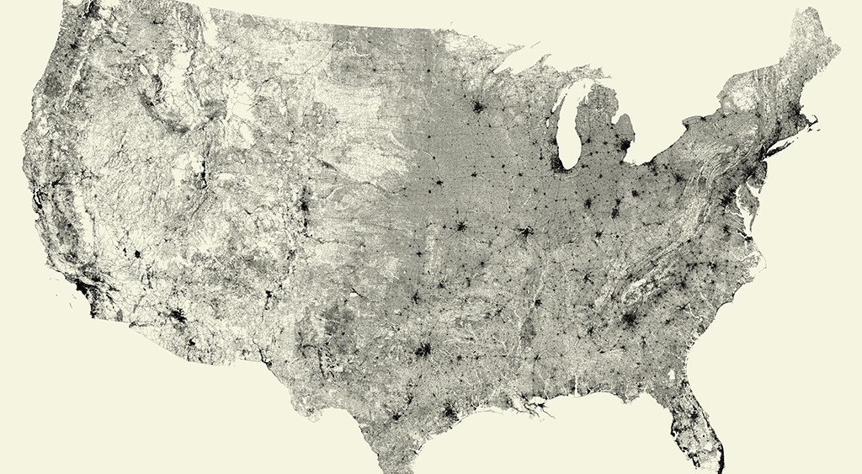

Our Shared Value: Open Spaces
(a map of road concentrations in the USA)

Slide 4
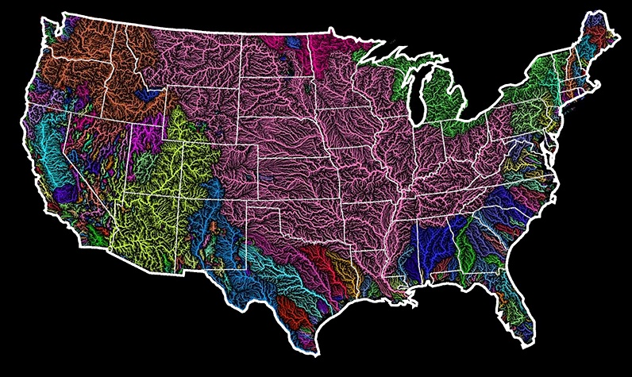

Upper Yellowstone Watershed
You Are Here

Slide 5
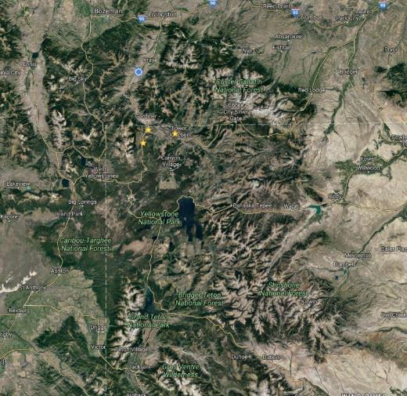
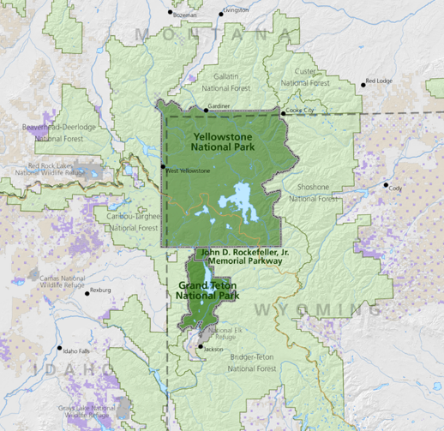

Geographical Context: Valley of the Volcano
Notes:
Largest known volcano
Most geysers in the world
2nd Highest Lake over 7k ft
Largest Concentration of Large Mammals – Grizzlies, Lynx, Wolves
Thermophiles evidence early evolution of life
Source of the longest undammed river in the lower 48 states
World’s first national park…and to get to it, you go through PV.
Paradise Valley is bookended by two cities: Livingston and Gardiner
Clark’s camped at Livingston. He wrote on July 15, 1806, after leaving the Three Forks in part notes:
"Proceeded up the branch (of the Gallatin) to the head thence over a low gap in the mountain thence across passing over a low dividing ridge (Bozeman Pass) to the head of a water course (Billman Creek) which runs into the Rochejhone (now the Yellowstone), prosueing an old buffalow road keeping on the North Side of the branch to the River rochejhone at which place I arrived at 2 P M.“
Clark peered south into the Paradise Valley and later recorded: "The Roche passes out of a high rugid mountain (most likely he was referring to the Gallatins) covered with Snow … The mountains (Absarokas) … on the East side of the river is rocky rugid and on them are great quantities of Snow."
Livingston:
In 1873, when Amos Benson built a trading post, stage stop and, of course, a saloon on the banks of the great Yellowstone River about four miles downstream from today's Livingston, Benson's Landing was established, and the area came to life. A rickety ferry rigged across the Yellowstone by another "entrepreneur" - Bill Lee - carried passengers headed to the Paradise Valley and Yellowstone National Park. In July 1882, railroad surveyors set up a camp called Clark City near the Big Bend. When the rails reached the town on Dec. 1, 1882, Clark City already had six general stores, two hotels and 44 other establishments, of which 30 were saloons. With a profit to the tune of $200,000 as an incentive (railroad land sales), NP officials decided the town needed to be downriver a short ways. Town folks bought lots and moved. A town was platted and named for Crawford Livingston, a director of the Northern Pacific Railroad. A Wild West town of legend, attracting characters such as Calamity Jane, it took 30 saloons to help quench the thirst of the nearly 2,000 early residents who made Livingston the largest neighborhood on the Yellowstone. It was the railroad that made the place work, especially when a locomotive-repair shop was put into operation. Tourism and outdoor recreation soon added to its economic coffers.
Gardiner:
Recreating what he lost in Mammoth, McCartney built a small hotel, shop, and saloon along the west end of present day Park Street in Gardiner where the beer was said to be disappointing. McCartney’s new claim was also inside the park, although no one knew it at the time since Yellowstone’s boundaries were imprecisely drawn. The following year McCartney added a post office making Gardiner official and McCartney its unofficial mayor.
The youthful town of Gardiner began to grow and by 1883 boasted “…six restaurants, five general stores, two hardware stores, two fruit stands, two barber shops, a newsstand, a billiard hall, two dance halls, four houses of ill repute, a blacksmith shop, twenty-one saloons, and a milkman,” remarked one visitor.
The year 1883 nearly burgeoned for this nascent community. A gold claim was discovered by Buckskin Jim Cutler (so named for the buckskin jacket he wore in an easterner’s misguided notion of western garb). The same year, the Northern Pacific Railroad announced that Gardiner would be the southern terminus of the Park Branch and began promoting Yellowstone as a travel destination.
But “Buckskin” Jim Cutler’s claim sat squarely on the proposed Park Branch terminus. Cutler dug his heels in. McCartney was not happy and he and Cutler feuded over the claim and the future of Gardiner. The Northern Pacific Railroad, hoping to settle with Cutler, began laying tracks, but making little headway with “the tough old codger,” terminated the line at Cinnabar, three miles north of Gardiner.
It was a huge blow and one that would hinder Gardiner’s growth for the next 20 years.
One early visitor described Gardiner as “no more than a collection of tents and log huts. A veritable Shantyville, Gardiner City, an ideal squatter town with the rudest houses made of unseasoned boards, with not a few tents mingling with the more pretentious huts, huddled together as though the land was valued by the foot and inch.”
But Gardiner’s residents were proud of their ramshackle town. It wasn’t much, but they’d built it with gnarled hands and fierce determination—people like McCartney, the unofficial mayor, and Billy Shrope who hauled water out of Gardner River selling it for fifty cents a barrel, and John Spiker who provided visitors with lodging at the Cottage Hotel.
Even after a carelessly dropped cigar in Cowell and Lewis’s Saloon (on Park Street) ignited a fire that swallowed 13 houses and 19 businesses in 1889, residents believed in Gardiner’s future enough to rebuild—no easy task without a railroad to ferry much needed supplies.
Gateway to Fairyland
In 1902, Gardiner’s residents breathed a collective sigh of relief when the Northern Pacific Railroad extended the tracks those last three miles. And with their next breath residents set to work on shedding the image that “there was nothing attractive [in Gardiner] nor curious enough to make [one] long to tarry,” according to one early visitor.
They began with the Roosevelt Arch—an idea conceived by Hiram Chittenden, an officer for the Corps of Engineers in charge of road design and construction in Yellowstone. In one of Gardiner’s proudest moments, nearly 4,000 visitors gathered around the unfinished basalt arch for the laying of the cornerstone by President Theodore Roosevelt on April 24, 1903.
“The flashing swords of the officers, the martial music of the band, and the lusty cheering of the assembled multitude,” admired one reporter, “gave the scene an aspect which would inspire enthusiasm and patriotism in the breast of a cynic.”
Eight years after the cornerstone was laid, Dorothy Pardo, riding beneath the arch in a stage coach, wrote that the arch gives “one the impression of space—breadth, height, and vastness…and one wishes that no others save those who love Nature in all her moods, might ever pass through the massive stone archway marking the entrance to the Nation’s fairyland.”
Four months after the cornerstone was laid, the last rough-hewn log was set upon Gardiner’s new train depot’s stone foundation. The depot was designed by Robert Reamer, famed Yellowstone architect of the Old Faithful Inn. Its rustic character introduced visitors to Gardiner’s authenticity as a real western town, not simply a tourist stop.
Visitors’ first glimpse of Gardiner, after stepping off the depot platform, was of Park Street—the town’s main hub that was built, inadvertently, inside the park boundary so that visitors stumbling out of Tripp and Melloy’s Saloon did so literally into Yellowstone Park.
Park Street bustled with a tailor’s shop, a post office, a restaurant, several saloons, a livery, and most prominent of all, W.A. Hall’s store.
Hall’s sold everything—a claim boldly painted in large white letters on the rust red bricks facing the depot. The faded letters can still be read today though Hall sold his business in 1955.
“If you want it, Hall has it from an ounce to a car load and from a needle to a saw mill,” read an advertisement in a 1903 issue of Gardiner’s Wonderland newspaper. Hall advertised wool blankets made in Big Timber and “Noxall shirts ranging in price from 50 cents up to $2.75…shoes of the best quality…and groceries.”

Slide 6
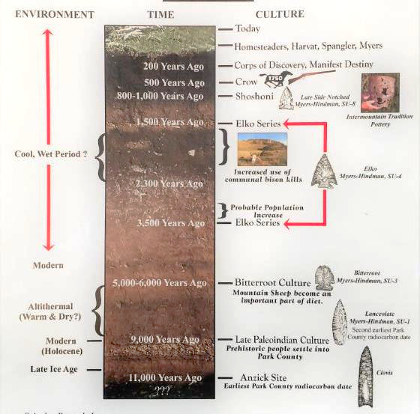
Ancient Human Timeline
Combining the information from the Anzick site, the Myers-Hindman and other archaeological finds in the Upper Yellowstone allows for a graphic description of culture, environment and time in Park County for the past 11,000 years.
© Anthro Research Inc

Slide 7
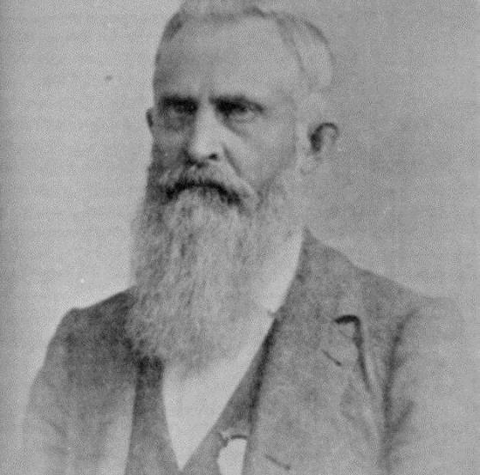
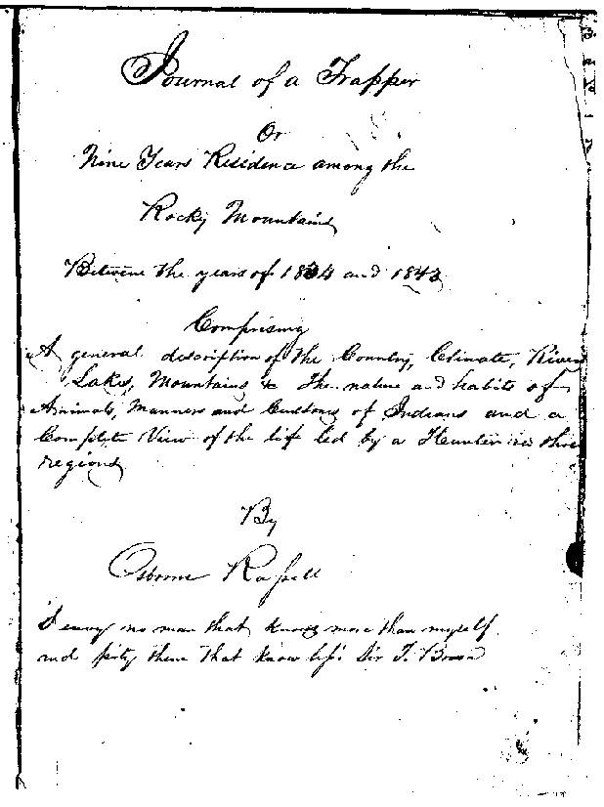
Trapping
[August] 25th left the defile and took up the Gallatin an East direction crossed the mountain and fell on to a stream running into the Yellow Stone and finding no beaver returned to the Gallatin the next day.
- Osborne Russell 1835
Notes:
William Clark commented on the abundance of furbearing animals: "the Yellowstone and its tributaries . . . abound in beaver and otter."
Famed trapper and mountain man Jim Bridger is claimed to have wintered in 1844 down in secluded Paradise Valley which lies between Livingston and Yellowstone National Park. Accompanied by Crow Indians, they left a large pile of deer, antelope, elk and buffalo skulls as a monument to their sojourn. In years that followed, large ranches took hold in Paradise Valley by such notables as Nelson Story who, allegedly, became the inspiration for Larry McMurtry’s Pulitzer Prize-winning epic, and subsequent movie, “Lonesome Dove.”
Johnston Gardiner, an old trapper in the Upper Yellowstone during the 1830s, is the settlement's namesake.
One of the first written accounts is from Osborne Russell, in 1835.
What is Trapping? Is it hunting? Agriculture? Survival? Tourism trinkets? Just like the native americans, it was all of the above, and it was the closest that Europeans came to living in the area without the trappings of its eastern neighbor’s creature comforts. Osborne called the Shoshone’s “sons of the wilderness.”

Slide 8
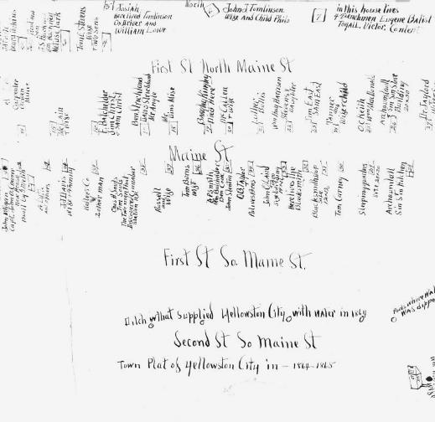
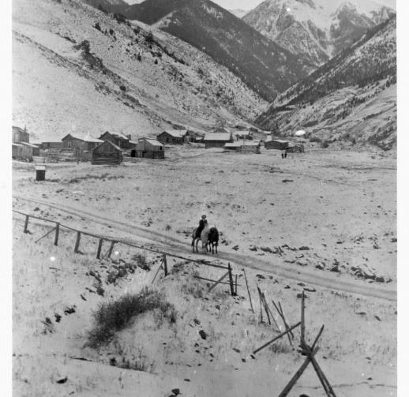
Emigrants
1864-65 Yellowstone City
Old Chico
Notes:
In late August 1864, a group of emigrants heading west missed Bozeman Pass and, instead, turned south into the Paradise. They made their way toward the peak and well into Emigrant Gulch and Creek and found placer gold. Yellowstone City, a short-lived camp of 300 people was born, becoming the first settlement in the Yellowstone Basin. The gold played out in three years, and the miners and their families moved on.
At the mouth of Emigrant Gulch, Old Chico, another mining camp with its nearby hot springs was built. Jim Bridger along with a band of Crow Indians wintered here in 1844.
Nelson Story, a prominent early Montanan drove Texas cattle into the Paradise Valley in 1867 and established a sizable ranch selling beef to the miners and other settlers. It was probably Story, or one of the other first settlers to make it here, who came up with the title Paradise for this piece of the Yellowstone River's way, known for its grand scenery, numerous spring creeks and some of the nation's best trout fishing.

Slide 9
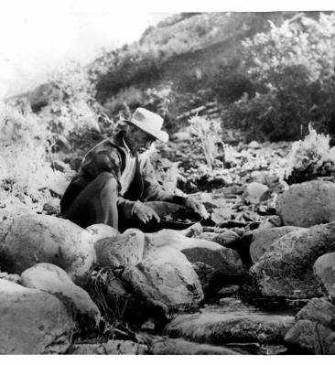
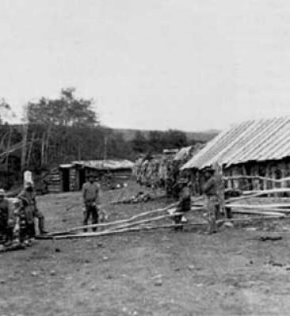
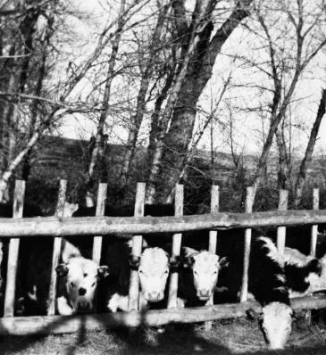
Mining, Hunting and Livestock
Notes:
In 1864, with emigrants headed for Virginia City and the Gallatin Valley, Bridger knew of a route to the Yellowstone River, an alternate to the better-known Bozeman Trail.

Slide 10
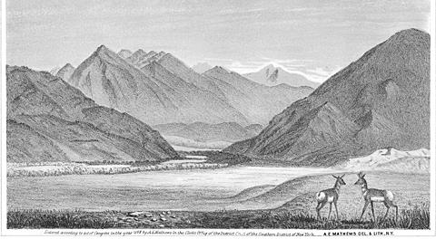
1867
Notes:
Alfred E. Mathews, a veteran of the 31st Ohio Volunteers in the Civil War, and famous for his on-the-spot drawings of battle scenes, especially "The Siege of Vicksburg" (1863), was one of the first American artists to focus attention strictly on the scenic highlights of the West, with a book of sketches of the Colorado Rockies (1866), and another of views of mountains along the Union Pacific Railroad (1869).
Mathews was deeply moved by the scenery in the region that as recently as 1864 had become known as Montana Territory. He himself wrote of this particular vista:
“Nothing can exceed the grandeur of the mountain scenery of the upper Yellowstone. The view represents its exit from these mountains, as seen from a point three miles below, and thirty miles from Bozeman, in the Territory of Montana. At the time the sketch was made (1867) no white inhabitants lived in the valley below the canyon, but several mining camps had been established in the mountains along the river and some of its tributaries. In the foreground of the view two antelopes are seen. These animals are quite numerous in the region, and during two days that the artist remained in the valley, he saw many large and small herds. Elk and mountain sheep also abound, and have frequently been seen in immense droves.”

Slide 11
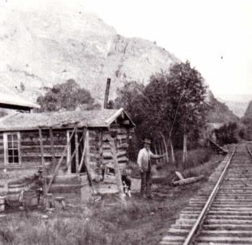
Railroads & Roads
Notes:
Two major events placed Paradise Valley and it’s bookends, Livingston and Gardiner, firmly on the map in the 1800s: railroads and tourism. The Northern Pacific Railroad’s strategic decision to locate its locomotive repair shops here. The shops grew to become the largest such facility between Seattle and Saint Paul. At one point the railroad industry employed 2,200 in Livingston, and it was primarily due to the influx of materials and burgeoning opportunity that the impressive buildings one finds in Livingston today came into existence.
This now abandoned railway line runs from Livingston south to Gardiner at the north entrance to Yellowstone National Park. The line was first completed from Livingston to Cinnabar in 1883 by the Rocky Mountain Railroad of Montana and leased to the Northern Pacific Railroad. In 1898, it was sold outright to the NP who then extended it to Gardiner in 1903.
But before railroads, there were roads. Before roads, trails. Before humans, there were animals. Perhaps the most famous “road builder” was "Yankee Jim“, Jim George who in 1872 and blasted a path through the canyon's west side, opening the first road to Yellowstone National Park. He charged a fee to those who used it and provided a roadhouse for the visitors. Yankee Jim was a garrulous man who must have met thousands of tourists after he began collecting tolls in 1873. In 1883 the railroad took over Yankee Jim’s road bed, although they did build a bypass for him. Even after the county took over the road 1887, travelers continued to stop by Yankee Jim’s. In 1889 when British author Rudyard Kipling visited Yellowstone, a spur of the Northern Pacific carried passengers from Livingston, Montana, to the edge of the Park. But Kipling heeded advice from a fellow passenger and stopped to visit Yankee Jim George, the legendary operator of a toll road than ran through the canyon that still bears his name.
“…as regarded the merits of that particular reach of the Yellowstone. He said it was alive with trout. It was. I fished it from noon till twilight, and the fish bit at the brown hook as though never a fat trout-fly had fallen on the water. From pebbly beaches, quivering in the heat-haze where the foot caught on stumps cut foursquare by the chisel-tooth of the beaver; past the fringe of the water-willow crowded with the breeding trout-fly and alive with toads and water-snakes; over the drifted timber to the grateful shadow of big trees that darkened the holes where the fattest fish lay, I worked for seven hours. The mountain flanks on either side of the valley gave back the heat as the desert gives it, and the dry sand by the railway track, where I found a rattlesnake, was hot-iron to the touch. But the trout did not care for the heat. They breasted the boiling river for my fly and they got it. I simply dare not give my bag. At the fortieth trout I gave up counting, and I had reached the fortieth in less than two hours. They were small fish—not one over two pounds—but they fought like small tigers, and I lost three flies before I could understand their methods of escape. Ye gods! That was fishing.”
— Excerpt from From Sea to Sea: Letters of Travel, Volume Two, Rudyard Kipling, 1899. (Page 203−205).
When President Roosevelt came to the park via the rails in 1903, he asked to have the crusty Yankee Jim, who still lived in the area, come meet him. The reply to the invitation was, "You know where I live Teddy." But before then, the trails were used by native people’s, preferring the western side of the Yellowstone all the way to Mammoth where it split and ended up on both sides of the continental divide.

Slide 12
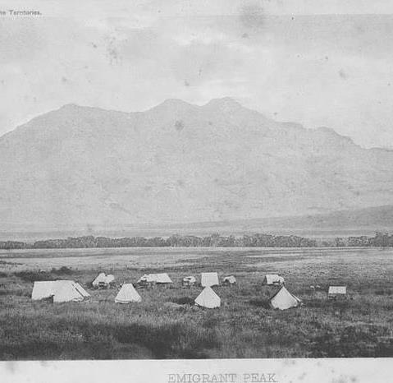
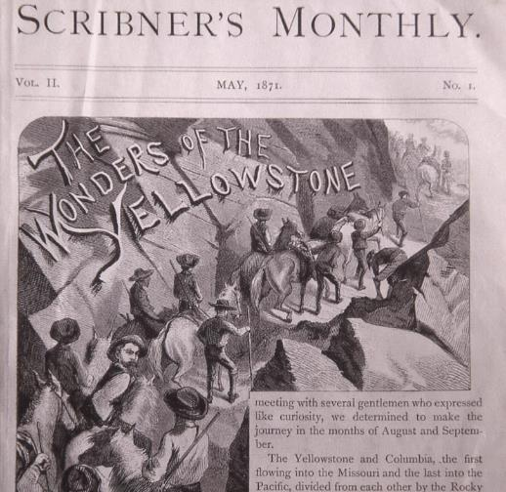
Tourism

Slide 13
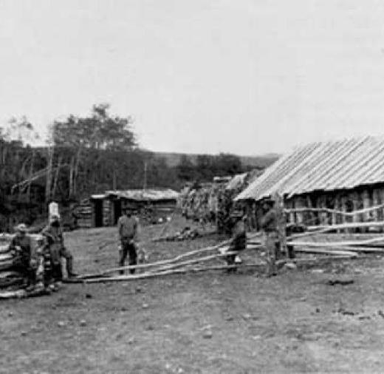
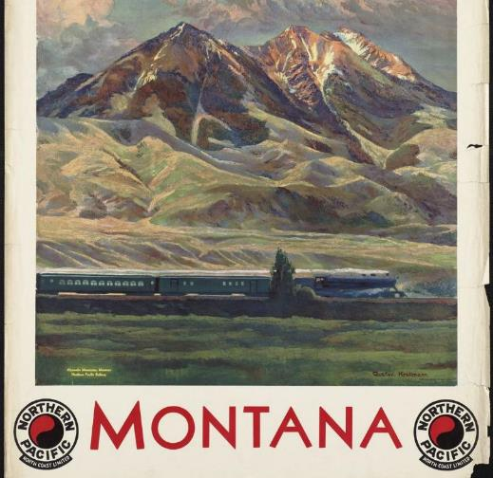
Tourism & Retail
1871
1931
Notes:
Perhaps the best description of Paradise Valley I’ve ever seen is Thomas Wolfe’s description as he drove through in 1938 takes notes for his next masterpiece that never came to be due to his untimely death. Having just left Gardiner, and as he came out of Yankee Jim Canyon driving north, the valley opened before his eyes and he wrote two words: “nude spaciousness” – Thomas Wolfe, A Western Journal
The second event was the creation of Yellowstone National Park and the arrival of tens of thousands of tourists to this northern gateway. This is where Yellowstone Park tourism began; not Wyoming or Jackson Hole. Hard to imagine, but once Northern Pacific completed its spur line south to the small town of Gardiner near the park’s boundary, as many as 30,000 Yellowstone visitors were known to travel on upwards of six trains daily in subsequent years, according to the brochure. The age of industrial tourism had begun.
Between the railroad’s arrival and Yellowstone’s protection, commercial growth of Livingston as a hub was inevitable and astounding beginning in 1882. Within twenty-seven years, banks, factories, merchant blocks and lumberyards exploded on the scene in a frenzy. To accommodate new arrivals, and the endless parade of tourists domestic and foreign, 13 hotels were built between 1883 and 1914 which lodged dignitaries and politicians from the New as well as the Old World.

Slide 14
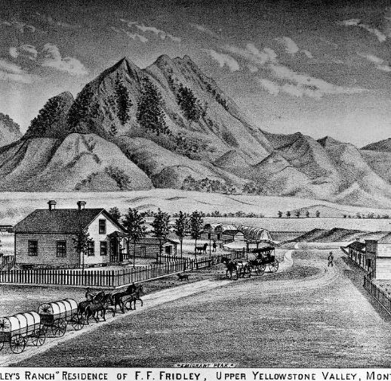
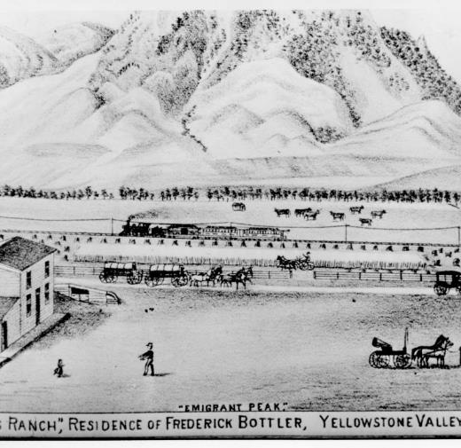
Homesteading & Agriculture
Fridley’s
Bottler’s

Slide 15
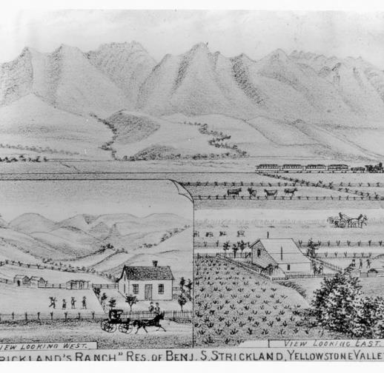
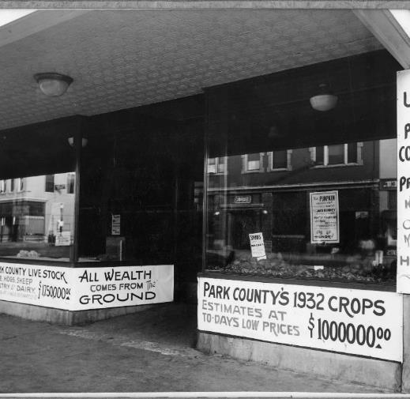
Agriculture & Retail
Stricklands
Road
Notes:
Perhaps the best description of Paradise Valley I’ve ever seen is Thomas Wolfe’s description as he drove through in 1938 takes notes for his next masterpiece that never came to be due to his untimely death. Having just left Gardiner, and as he came out of Yankee Jim Canyon driving north, the valley opened before his eyes and he wrote two words: “nude spaciousness” – Thomas Wolfe, A Western Journal
The second event was the creation of Yellowstone National Park and the arrival of tens of thousands of tourists to this northern gateway. This is where Yellowstone Park tourism began; not Wyoming or Jackson Hole. Hard to imagine, but once Northern Pacific completed its spur line south to the small town of Gardiner near the park’s boundary, as many as 30,000 Yellowstone visitors were known to travel on upwards of six trains daily in subsequent years, according to the brochure. The age of industrial tourism had begun.
Between the railroad’s arrival and Yellowstone’s protection, commercial growth of Livingston as a hub was inevitable and astounding beginning in 1882. Within twenty-seven years, banks, factories, merchant blocks and lumberyards exploded on the scene in a frenzy. To accommodate new arrivals, and the endless parade of tourists domestic and foreign, 13 hotels were built between 1883 and 1914 which lodged dignitaries and politicians from the New as well as the Old World.

Slide 16
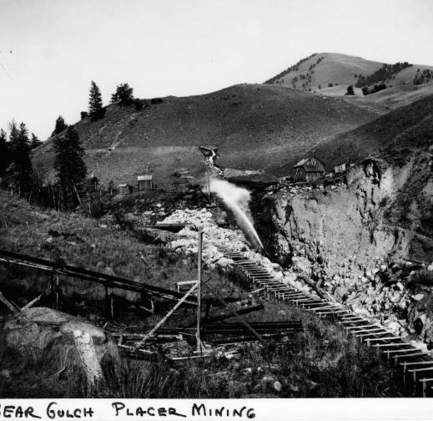
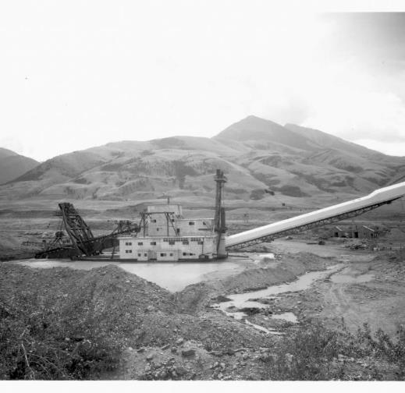
Mining
1885 Bear Gulch
1941 to 1947

Slide 17
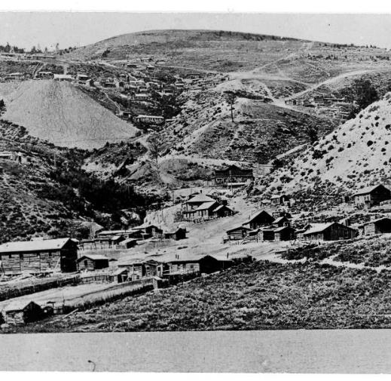
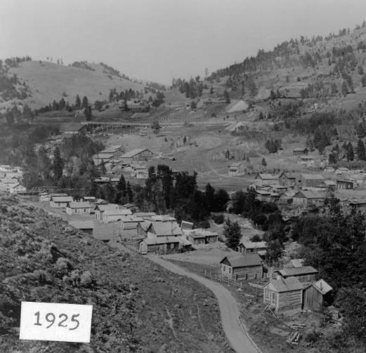
Mining
Aldridge
Jardine

Slide 18
Land Use and
Economics

Slide 19
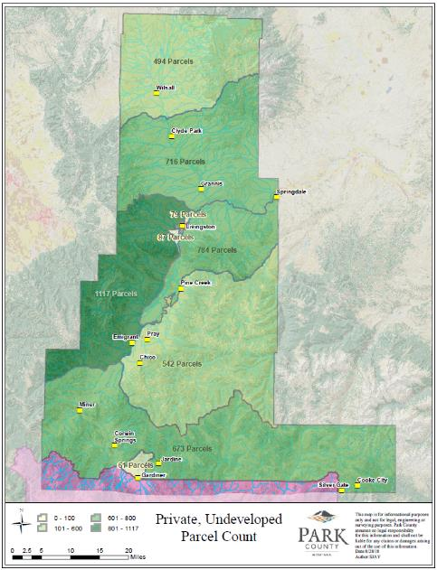
Key Land Use Trends
Population in Park County grew by 4,285 residents between 1970 and 2010.
Livingston added only 117 residents in that timeframe, amounting to an additional 4,168 living out in the county.
4,553 undeveloped parcel in Park County as of 2018
Influx of more intensive and diverse uses (e.g. Sage Lodge and Yellowstone Hot Springs)
Fewer subdivisions
21 new lots created through subdivision exemptions from 2017 – Present
Major increase in short-term rentals from AirBnB, VRBO, Homeway, etc (e.g. 363 short-term rentals listed in Paradise Valley on VRBO)

Slide 20
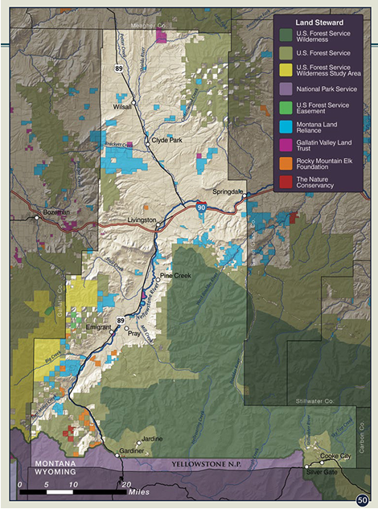
Lands Under Public & Private Resource Management
Notes:
Source: The Atlas of Park County Montana, 2013, protected lands (p. 50

Slide 21
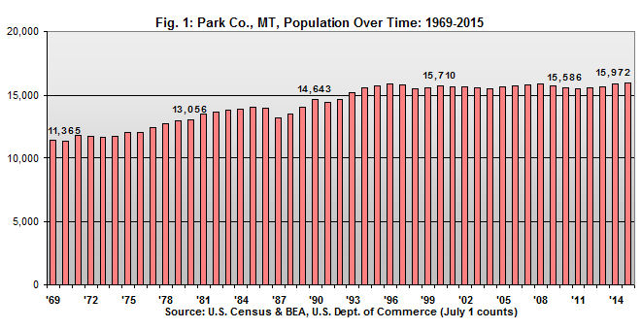
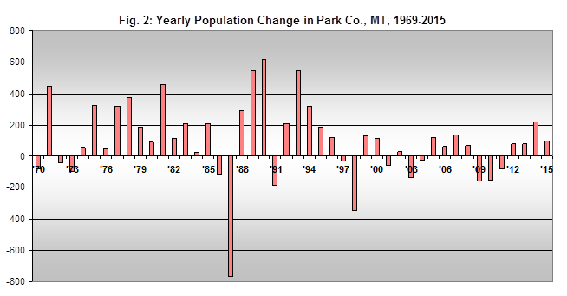
Population Trends
Year-to-year population change by Park County is shown in the chart at the bottom right. Years when significant population declines occurred tend to coincide with national economic recessions, such as in 1991, 2001, and, more recently, in 2009, 2010, and 2011. A very sharp decline in 1987 coincides with very difficult financial times in agriculture and in the wood products sector, as well as in housing.
Growth is now continuing and the county’s population was recently estimated by the U.S. Census Bureau at 15,972 in July, 2015.

Slide 22
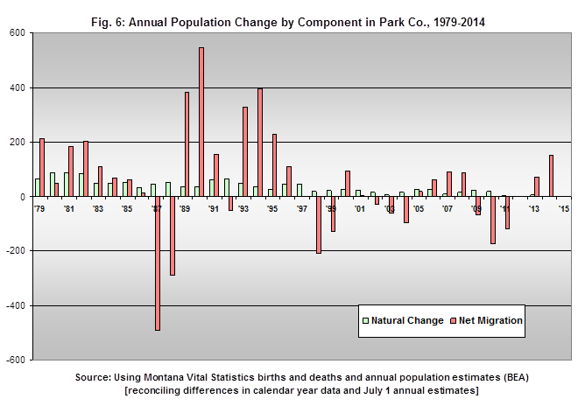
Population Change Trends
The biggest driver of population growth in Park County by far is positive net migration (red bars). Again, net migration is positive when the number of people moving to the area is greater than the number moving away, counting only those who change their county of permanent residence in the process – which ignores part-time residents of the county who do not or have not become permanent residents.
During the ‘90s when growth in the county was greatest, over seventy-five percent of this growth was accounted for by positive net migration.

Slide 23
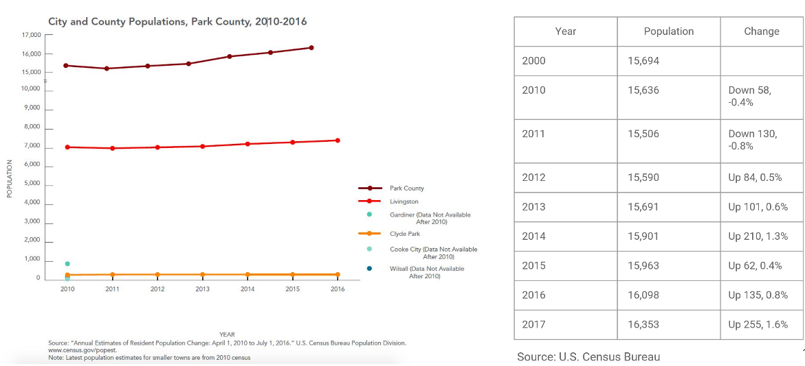
Population Trends by Area

Slide 24
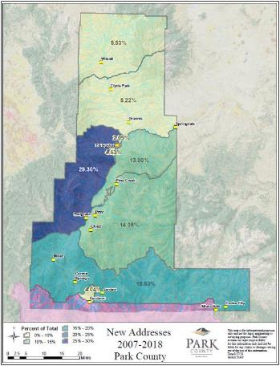
New Address Assigned from 2007 to Present
766 “unincorporated” new addresses
Distribution

Slide 25
County Tools Used to Manage Land Use and Growth
Subdivision Regulations: Evaluates a wide spectrum of potential impacts as part of the review process but with over 4,500 undeveloped parcels we are not seeing a lot of subdivisions.
Floodplain Regulations:
  Jurisdictional authority is only within the FEMA designated Special Flood Hazard Area.
  Primary concern is protection of life and property for insurance purposes, not environmental protections or growth management.
  National program is not very flexible to adapt to local needs.
Buildings for Lease or Rent Regulation
  Reviews for a variety of impacts.
  Only covers parcels with 4 or more rental units.
  Wide variety of exemptions means that we have only reviewed one property under these regulations since they were adopted in 2013.
Zoning
  Can help manage growth through tools like density standards, setting allowable land uses, and setbacks.
  Not widely used in Park County.
Growth Policy

Slide 26
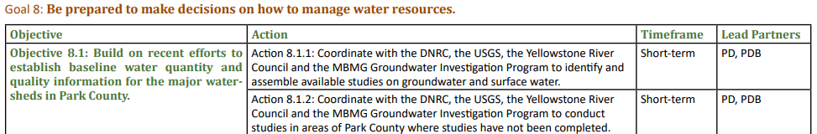
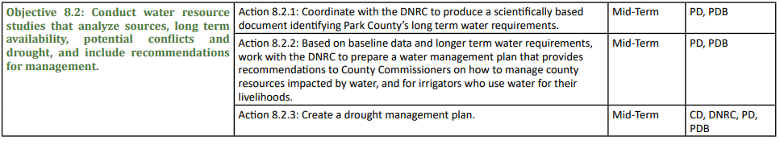
County Growth Policy: Water Quality & Availability

Slide 27
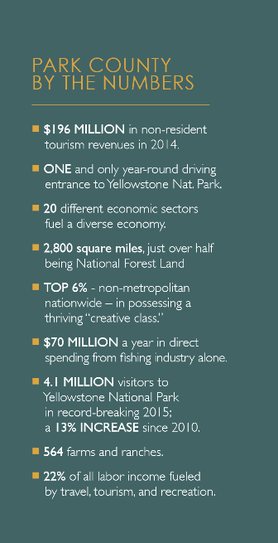
Key Economic Trends
The combination of high area natural amenities, high levels of creative occupation employment, and strong entrepreneurial cultures are referred to by ERS economists as the “trifecta” in terms of underly attributes for economic growth and vitality. Park county is one of only several hundred rural counties across the US that appears to possess all three attributes.
Income on a per-person basis in 1990 was $20,980. By 2000 this had grown to $28,156 and more recently in 2014 had reached an all-time high of $40,614. Park County per capita income was less than the statewide level in 2001 – $29,890 vs. $31,870 for the state as a whole. But the 2014 Park County per capita income level exceeds the state level -- $40,614 vs. $39,903.
Proprietor or self-employment represents a significant portion of all employment in Park County, accounting for 39% of all jobs in 2014. This has grown over the last decade from about one-third of all jobs before 2000 and this growth has been entirely among non-farm proprietors. Statewide in Montana proprietors accounted for 27% of all jobs in 2014, up only slightly from 26% in 2000.
The poverty rate in Park County also is lower than statewide with poverty in Park at 12.3% versus 15.2% statewide.
Notes:
Source: McGranahan, Wojan, and Lambert, “The Rural Growth Trifecta: Outdoor Amenities, Creative Class and Entrepreneurial Context,” Journal of Economic Geography, 4-10-2011
http://joeg.oxfordjournals.org/content/early/2010/05/12/jeg.lbq007.full

Slide 28
Key Economic Trends (continued)
Tourism Trends: In 2017, residents spent nearly $2.87 billion on trips 50 miles or more away from home but still in Montana. In comparison, 12.5 million non-resident travelers came to Montana and spent $2.8 billion supporting 39,000 jobs and indirectly contributed an additional $1.9 billion and a total of 53,000 jobs. Total travel industry spending in Montana is $6.23 billion dollars; 54 percent contributed by nonresidents and 46 percent by resident travel within the state.
  Park County ranks #1 in Montana in non-resident traveler expenditures among major destination counties (per capita).
  Angling spending amounted to $70 million a year during these fishing trips, compared to the estimated $5 to $6 million a year spent by hunters while hunting in Park County area hunting districts.
  The Montana Bed Tax alone, in Park County, generated $1.7m in tax revenue to the state and local tourism boards in 2017.
Agriculture Trends: In 2012, there were 774,000 acres of land in farms, with an ave size farm of 1,372 acres and total of 564 farms. The market value of products sold was $38M with an average of $68k per farm. This represents a growth of over 30% in value from the 2007 census.
Housing and Part-Time Resident Trends:
  Park County is a net importer of labor income. A significant and growing number of county residents work outside of the county, but choose to live in Park County and not in the county where their workplace is located.
  “Total assessed value” of taxable property in Park County was $1,536,517,157 (roughly $1.54 bil). Of this total “Residential property” excluding “Residential Low Income” homes and “Mobile Homes” accounted for 57.3 percent of this total assessed value in Park County, or $879,923,187 ($880 mil.). This percentage compares with 47.1 percent statewide, indicating the above average dependency of Park County on this type of property within the county’s overall tax base. (During the 2000 to 2010 housing units increased significantly in spite of little change in the resident population. This indicates that there are a growing number of part-time residents who are building and buying homes in the county.)
  Homes valued between $500 thousand to one million dollars are 11.1% of Park County houses versus 5% of homes statewide and 8.2% nationally. Park County also has a larger percentage of homes $300-to-$500 thousand in value than statewide and nationally.
Notes:
Source: McGranahan, Wojan, and Lambert, “The Rural Growth Trifecta: Outdoor Amenities, Creative Class and Entrepreneurial Context,” Journal of Economic Geography, 4-10-2011
http://joeg.oxfordjournals.org/content/early/2010/05/12/jeg.lbq007.full

Slide 29
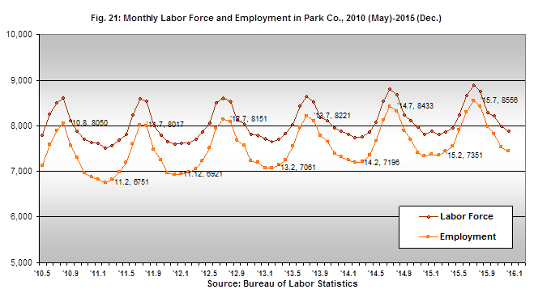
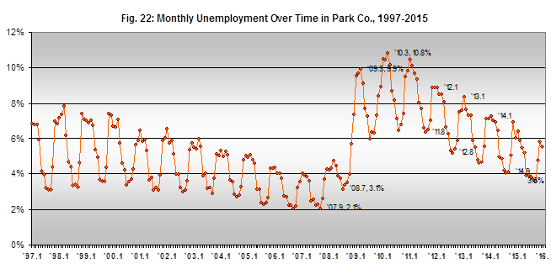
Employment Trends: Seasonality
Figure 21 below shows data on monthly employment and labor force numbers for Park County over the last five years (2010 through 2015). The ebb and flow in the size of the area labor force (shown in brown) and in the number of persons employed (shown in orange) are clearly evident.
In Park County much of the seasonality in employment is being greatly affected by area patterns in visitation and traveler activity. County employment reaches highs each year in mid-summer, ordinarily in July, and lows occur usually in February. Over time, July peak employment levels are rising, from 8,050 jobs in 2010 to 8,221 in 2013 and to 8,556 in 2015. July unemployment fell to 3.3% in 2016.
The labor force of the county is gradually increasing in number, indicated in Figure 21 by the brown line. The July, 2015, labor force was estimated at 8,895 and this is the highest estimate for the county’s labor force in its history.

Slide 30
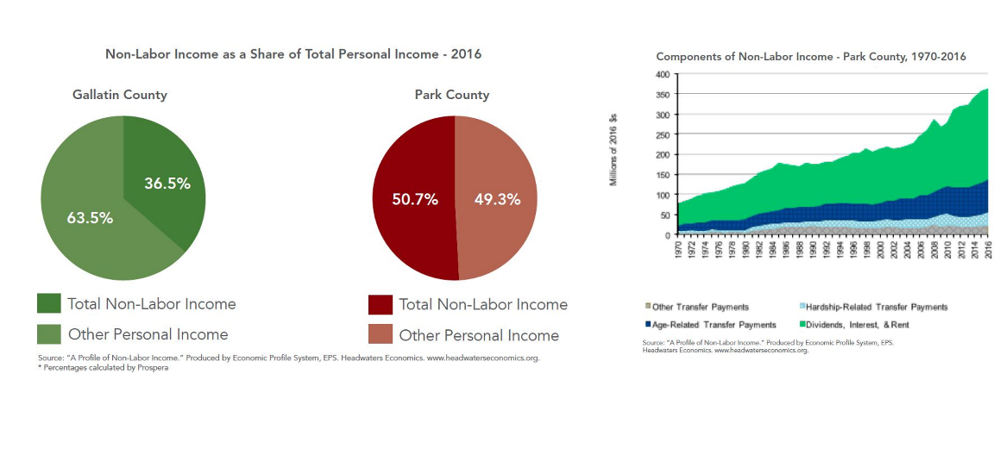
Employment Trends: Non-Labor Higher than Gallatin

Slide 31
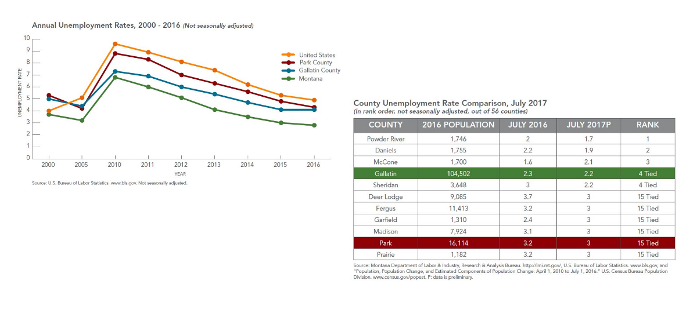
Unemployment Trends

Slide 32
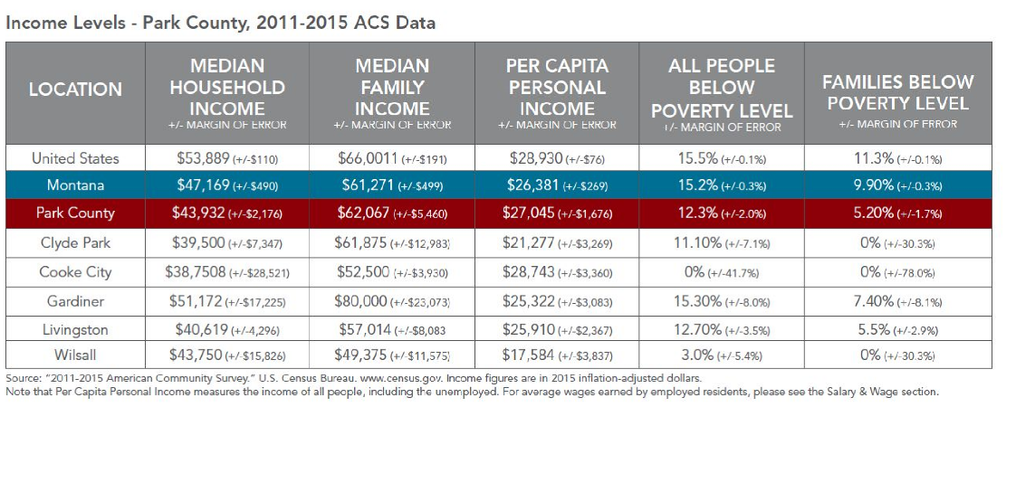
Poverty Trends

Slide 33
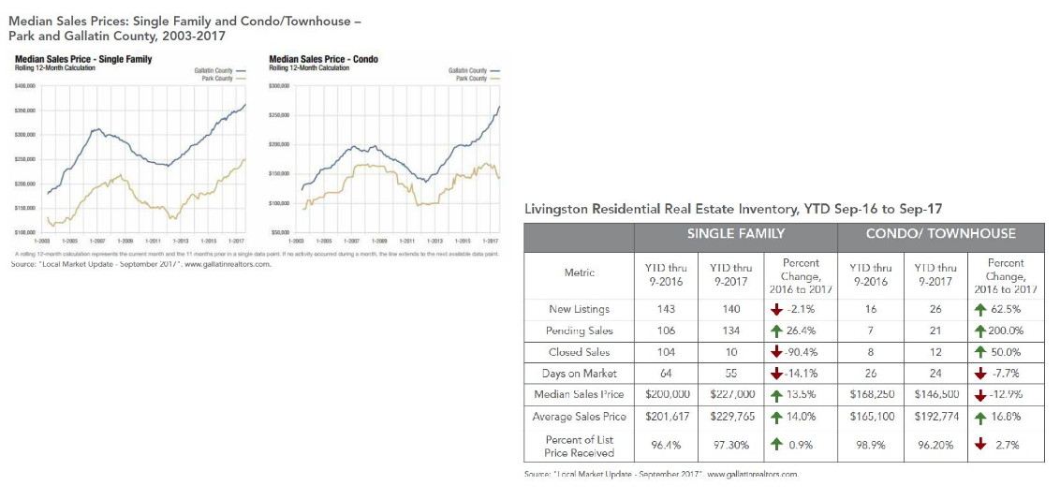
Housing Cost Trends

Slide 34
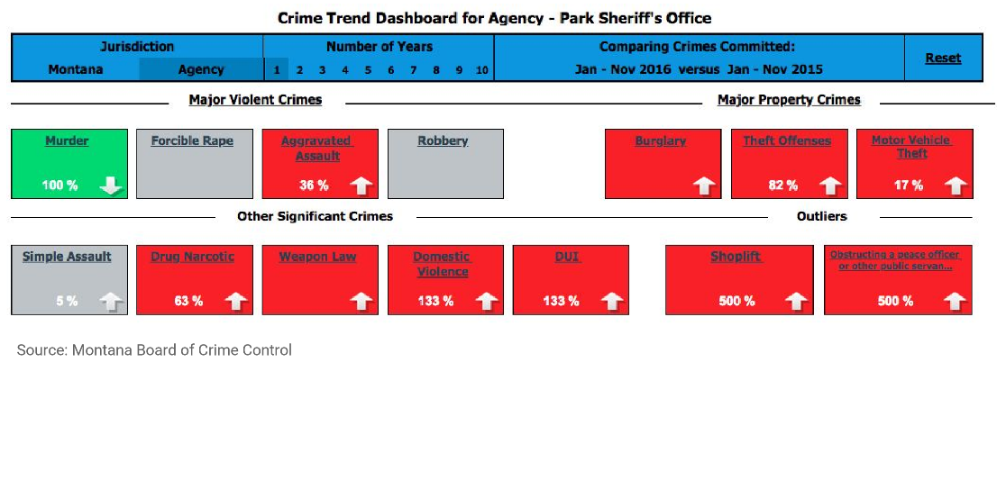
Crime Trends

Slide 35
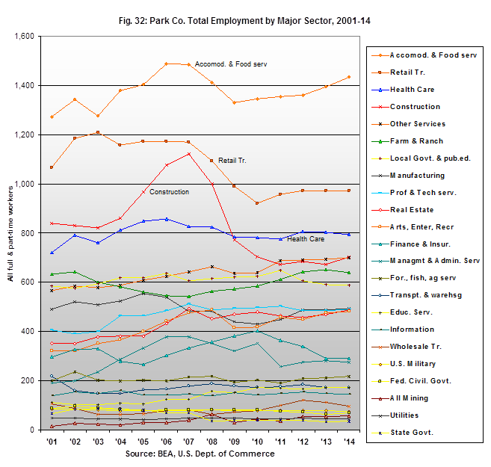
Employment by Sector
The sector with the highest level of total employment in the county is “accommodations and food services,” which includes all types of lodging (hotels, motels, B&Bs, resorts, etc.) as well as restaurants, cafes, bars, etc.

Slide 36
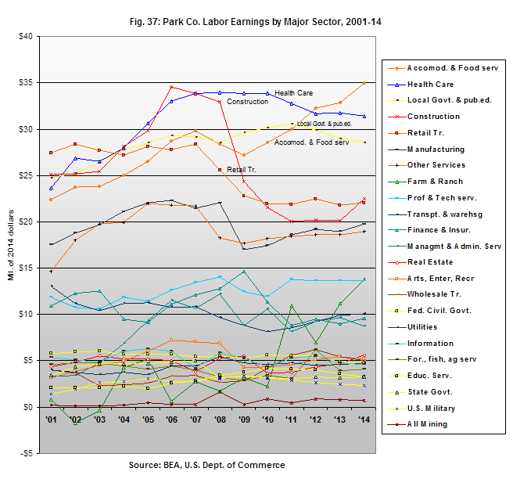
Labor Earnings Trends
Labor earnings in the accommodations and food services sector rank highest among all sectors in 2014 at about $35 million. These have been rising rapidly over the last several years and are, again, indicative of the area’s prowess as a place for travelers.
Health care, highest among all sectors statewide in Montana, is second in Park County at about $32 million, down a bit from highs from 2007 to 2010. Local government, which includes municipal and county governments and all public education, is third at $28.6 million, also down from a high three years ago.
The construction sector ranks fourth at $22.4 million. This is down considerably from a high in 2006 of almost $35 million. Stability was achieved in construction by 2010 and it has begun to rise once again.
Notes:
Figure 37 shows levels of labor earnings for all of the major sectors of the economy. Annual labor earnings for each sector are shown from 2001 to 2014 in inflation-adjusted dollars with these ranked from top to bottom in the chart by total labor earnings in 2014.

Slide 37
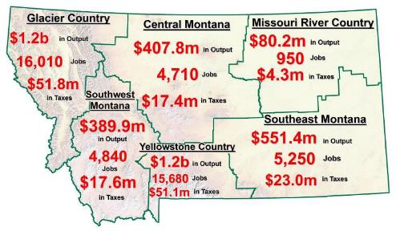
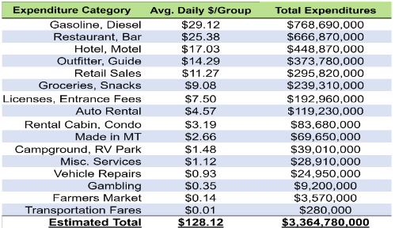
Tourism Trends: Non-Resident Spending
According to a survey of non-resident travelers in 2017, the time spent on various activities are ranked as:
  56% Scenic driving
  36% Day hiking
  34% Wildlife watching
  29% Nature photography
  26% Camping
  24% Recreational shopping
  19% Visiting other historical sites
  17% Visiting local brewery
  12% Visiting museums
  12% Visiting Lewis & Clark sites
  9% Fishing / Fly Fishingollows:

Slide 38
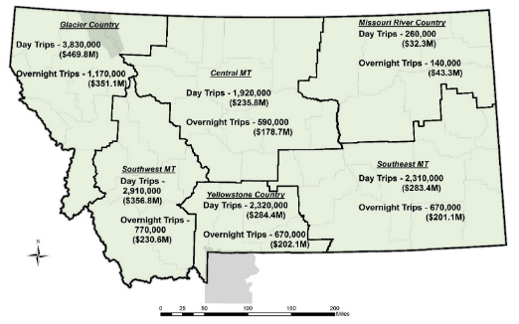
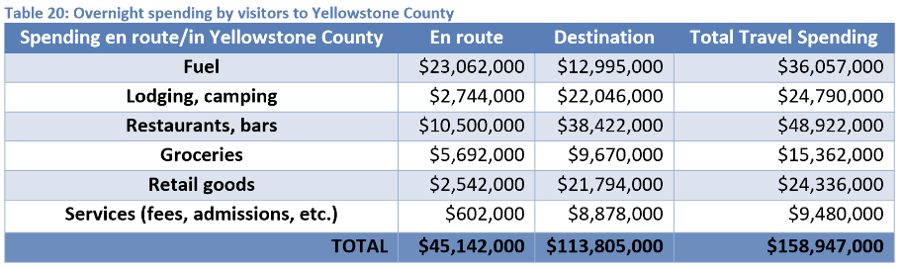
Tourism Trends: Resident Spending
Park County had 88,000 overnight trips resulting in $27,277,00 in spending.
Park County had 156,000 day trips resulting in $23,417,000 in spending

Slide 39
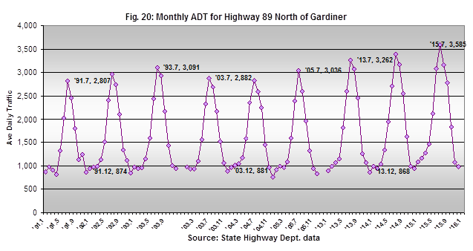
Tourism Trends: Gateway to Yellowstone
Figure 20 below focuses on the Highway 89 segment north of Gardiner only and includes monthly traffic data for 1991 through 1993, 2003 through 2005, and 2013 through 2015.
In July, 2005, the ADT count for traffic through this north gateway averaged 3,036 vehicles per day. Visitation to YNP for the entire year in 2005 totaled 2,835,650.
It rose to 4,097,757 in 2015 – an increase of 1,262,107 visitors or 45 percent. During this same time the ADT for July in 2015 at the north gateway to the park on Highway 89 was 3,585 vehicles a day.
This is an increase of 549 vehicles on average each day over the level in July ten-years earlier or an 18 percent increase in traffic.

Slide 40

Ranching & Ag Trends
Ranching & Agriculture plays a key role in preserving wide opens spaces in Park County that attract tourists and recreational dollars to the area. A total of 774,000 acres are contained within the county’s farms and ranches, both owned and leased lands, or about 1,210 square miles of land. This represents about 45% of the entire county land area.
Park County had 564 farms in 2012, up from 535 farms in 2007. Ninety-eight of these had sales of $100,000 or more, another 44 had sales of $50,000 to $99,999, and another 57 had sales of $25,000 to $49,999.
Farms as a whole averaged 1,372 acres in size, with 159 farms having 1,000 or more acres and 93 of these having more than 2,000 acres. These 93 together had 611,000 acres, about 79 percent of all land in farms, and averaged 6,570 acres in size.
Cattle numbered 44,400 in 2012 with 23,000 cattle and calves sold in the year. These cattle operations were on only 211 of the county’s farms and ranches. The county also had about 2,600 sheep. Thirty-one operations reported that they had some income from “agri-tourism and recreation services;” something increasingly common among farms in areas frequented by tourists and other visitors.

Slide 41

Construction Sector Trends
Dollars used in Figure 38 are inflation-adjusted, so you can easily see the relatively sharp rise in labor earnings for area workers in these sectors of the economy, with these earnings rising from very low levels in the late ‘80s of around $10 million annually to almost $40 million at the peak of activity in 2006.
This fell below $24 million in 2011 as the recession hit housing and construction throughout the U.S. Most of this decline in Park County was in labor earnings by those working as special trade contractors in construction.

Slide 42


Migration Trends
Income data for individuals is recorded or compiled according to a person’s county of “permanent residence.” So, personal income figures for Park County do not include the incomes of part-time residents who have not made the county their permanent residence.
The total personal income of residents of Park County has been growing at a good pace for a very long time and reached an all-time high of $645 million in 2014 (the most recent data)
As the area population continues to age and more residents reach retirement age, income from non-labor sources will rise more rapidly and continue to shift this balance away from labor income or employment earnings.

Slide 43
Groundwater Supply and Quality

Slide 44


Upper Yellowstone Setting
Intermontane Basin - ~ 1 M acres
Topographic Relief - >10,000 to 4,200 ft
Framed by Gallatin & Absaroka Ranges
Drained by Yellowstone and tributaries
Valley floor <1 to 8 miles wide
Irrigation & Irrigation Channels
Mining: Emigrant (Au, Ag, Cu, Mo, Pb), Jardine (Au, W, Ag, Cu, Pb), Trail Creek (coal)
Geothermal Features (Controlled GW Area)
Seismic Features
Montana Groundwater Assessment Program
Notes:
Allens Spur

Slide 45

Irrigation Channels
Montana Groundwater Assessment Program

Slide 46

Abandoned & Active Mines
Montana Groundwater Assessment Program

Slide 47

Geothermal Sites
Chico
La Duke
Bear Creek
Yellowstone
Controlled
Groundwater
Area
Montana Groundwater Assessment Program

Slide 48


Faults
Series of ‘range-front’ faults
  Down dropped valley bottom
  Accumulation of ‘basin-fill’ sediments
  Uplifted Mtn ranges (Absaroka Range)
Gallatin Range
A
Absaroka Range
A’

Slide 49


Surficial Geology
Basin Fill and Alluvium (Valley bottom)
Tertiary Absaroka Volcanic Rocks (Mountains)
Gallatin Range
Madison Limestone (Allenspur – N end of Valley)
Absaroka Range
PreC Meta-sedimentary Belt Rocks (Mountains – east)
Belt
Basin-fill
volcanics
volcanics

Slide 50



Generalized Aquifers
1) Basin-fill
Basin Fill and Alluvium (Valley bottom)
Gallatin Range
Absaroka Range
alluvium
Tertiary - sediments
2) Fractured Rock
Tertiary Volcanic Rocks (Mountains)
PreC Meta-sedimentary Rocks (Mountains – east)

Slide 51


Glacial Geology
Quaternary Basin Fill and Alluvium
Gallatin Range
Absaroka Range
Glacier
Till
Yellowstone
outlet glacier
Outwash
Till
Outwash

Slide 52






Glacial Geology
Eightmile moraine and outwash fan
Mapped till (Qgt)
Outwash
Outwash
Water well
Qgo
Eightmile Ck
Eightmile terminal moraine
Glacier
Qgo
Till
Water well
Qgt
Qgo
Qgt
Qgt
Qgt
Till
moraine
Till
Mill Ck
16K years ago….
Yellowstone River
Qgt
Mill Ck
(Lopez and Reiten, 2003)

Slide 53






Groundwater Development
?
Cumulative total

Slide 54



Groundwater vs Surface Water Use
Volumetrically - minor
Withdrawals
3.62 MGD
(2015)
281
Domestic
Irrigation
PWS
Stock
Industrial
3.6
USGS
USGS
(non irrigation)
3.1
1.7
USGS

Slide 55

___ Irrigation Canals
Irrigated lands
Groundwater Recharge
Precipitation*
Mountain front stream loss
Canal seepage – “Incidental Recharge”
Park Co. (USGS 2015)
Irrigates ~ 62,000 acres
Diverts ~ 312,000 ac-ft/yr
100’s of miles of canals
~ 5 ft of water per acre

Slide 56


___ Irrigation Canals
Irrigated lands
Groundwater Discharge
*
*integrated signal
1000
Base flow = groundwater discharge
1000 cfs = 1983 ac-ft/day = 724,000 ac-ft/yr
GW Withdrawals
3.8 MGD = 11 ac-ft/day
= 4,000 ac-ft/yr

Slide 57




Monitoring Network
monitored well
Groundwater level trends
Jul - Oct
“Incidental” recharge
YCGWA
Seasonal fluctuations
Climate
Seasonal fluctuations

Slide 58


Monitoring Network
monitored well
Groundwater level trends
Seasonal lag
Jul
Jan

Slide 59


Groundwater Quality - TDS
Secondary drinking water standard = 500 mg/L
exceedances:
8
3
Total dissolved solids (mg/L)
232
222
Bedrock
(n = 28)
Basin-fill
(n = 45)
Bedrock
Basin-fill
!
< 500 mg/L
500 – 1,000 mg/L
> 1,000 mg/L
"
(
)
!
"
(
)
"
)
Montana Groundwater Assessment Program

Slide 60


Groundwater Quality - As
Primary drinking water standard = 10 ug/L
(parts per billion)
exceedances:
2
8
Arsenic (ug/L)
1.8
2.0
Bedrock
(n = 28)
Basin-fill
(n = 45)
La Duke
Hot springs
Bedrock
Basin-fill
!
< 5 ug/L
5 – 10 ug/L
> 10 ug/L
"
(
)
!
"
(
)
"
)
Montana Groundwater Assessment Program

Slide 61



Groundwater Quality – NO3
Primary drinking water standard = 10 mg/L
No exceedances
Nitrate (mg/L)
0.75
0.69
Bedrock
(n = 28)
Basin-fill
(n = 45)
Bedrock
Basin-fill
!
< 2 mg/L
2 – 10 mg/L
> 10 mg/L
"
(
)
!
"
(
)
"
)

Slide 62
“The imperative need in groundwater development is to know what we are doing”
Harold Thomas, 1951
Groundwater is stored and transmitted through:
  Basin-Fill
  Fractured Rock Aquifers
Groundwater supplies all drinking water in the basin
Groundwater withdrawals small relative to ‘incidental’ recharge
  Implications for land-use and climate changes
  No depletion trends
Water quality generally good (outside of geothermal areas)
Montana Groundwater Assessment Program

Slide 63
Surface Water Supply

Slide 64
Existing & Future Challenges
Rural subdivision development
Availability of water for competing interests (irrigation, instream flow, municipal)
Stream channel alteration and stabilization
Invasive species
PKD
Timber harvest
Forest fires
Maintenance of water quality

Slide 65

Existing & Future Challenges Due to Climate Change

Slide 66



30% Decline in Peak Accumulated Snow (‘64-’17)
Northern Rocky Mountain Trend
Source: Greg Pederson, USGS Bozeman
(from National Geographic—courtesy of Mike Tercek)

Slide 67

Runoff Earlier? (Not Clear W/O Analysis of Longer Record)

Slide 68
Corwin Springs Gauge

Slide 69


Are Peak Flows Increasing?
Size of peaks not increasing
Peaks occurring 2 to 3 weeks
earlier
Pattern of peak flows shows no trend from 1880 to 2017—but does show annual variability due to natural cycles in climate and snowpack

Slide 70

Late Season (base flows) are Diminishing
25 to 35%
Decline in
August
Streamflow

Slide 71

Annual Volume of Runoff
Dry Year/Wet Year based on percentages of long-term mean:
Dry—less than 25% Below Mean—between 25 and 50%
Above Mean—between 50 and 75% Wet greater than 75%
1997
1996
2011
1987
2001
1930’s Drought
2000’s Drought
Graphs of annual discharge over time suggest lack of long-term trend or declining trend at Corwin Springs– depending on length of streamflow record analyzed

Slide 72

Paleo Tree Ring Reconstruction (1200 CE to 2004 CE)
1930’s
drought
longer
2000’s
drought
shorter

Slide 73
Conclusions
Snowpack in the Upper Yellowstone Watershed has declined by about 30% since 1950 and is melting 5 to 15 days earlier.
Runoff at Corwin Springs is starting 10 to 15 days earlier than 1940.
No trend in peak flows at Corwin Springs; peaks occurring 2 to 3 weeks earlier.
Late season “base flow” has declined 25 to 35% in Upper Yellowstone
Annual volume of water is highly variable since 1900 and shows multi- year wet and dry cycles; existence of trend depends on time period examined; decreasing trend of about 15% from 1975-2016
Increasing variability in year-to-year water supply with higher highs and lower low ( 2011 or 2018 runoff could be followed by extended drought);
Increasing variability in irrigation water supply and length of growing season;
Aquatic ecosystems will be more stressed by elevated water temperature and changes in the pattern of runoff;
Competition for existing uses of water (for example irrigation and instream flow) is likely to increase;
Get used to smoky summers.

Slide 74
Surface Water Quality

Slide 75


Impaired Status Reports

Slide 76

Shields Drainage Impairments

Slide 77

Upper Yellowstone Impairments

Slide 78

Upper Yellowstone Impairments

Slide 79
Causes of Impairment
9 Waterways Listed Metals (5 have TMDLs)
13 listed for sedimentation (3 have TMDLs)
6 listed for nutrients
4 listed for Chlorophyll-A (Algae)
2 listed for Temperature
13 listed for flow regime modification
9 listed for alteration of stream-side littoral vegetation
7 listed for substrate alterations
2 listed for fish passage barriers

Slide 80


Arsenic Study
Yellowstone caldera and surrounding area has high arsenic levels in the water (above 10 mg/L is the human health standard)
MT law states that DEQ cannot set standards below natural conditions

Slide 81

Dissolved Oxygen (5 mg/L is standard for early life stages)

Slide 82

Total Phosphorus (Proposed Standard is .03-.066 mg/L)

Slide 83

Nitrate + Nitrite (Nitrogen – Standard is .01 mg/L)

Slide 84

Temperature – Corwin Springs

Slide 85

Temperature – Carter’s Bridge

Slide 86


DEQ Water Quality Assessment & TMDL Project

Slide 87

What is Measured?

Slide 88
Montana Climate Trends & Water Supply

Slide 89





Paleoclimate Studies in GYE are Extensive

Slide 90

800,000 Years of CO2
Atmospheric CO₂ levels of 410 ppm

Slide 91

Last 11,000 Years

Slide 92
Climate Facts
Last 115 years are the warmest of the last 1700 year, 1.8F increase in US
2013-17: warmest five years on record in US and globally
May 2018: warmest of last 124 years in US (5.2F above ave)

Slide 93

Montana Climate Assessment (montanaclimate.org)
  Listening sessions and questionnaires
  Stakeholder responses informed the MCA strategy
    Critical decisions and issues impacted by climate
    What type of information they need
    How to disseminate useful information

Slide 94

Greater Yellowstone Climate Assessment
Notes:
Craig & Hansen 2015

Slide 95


Predicted Temperature Increases by Mid-Century
RCP 4.5 (2040-2060)
RCP 8.5 (2040-2060)
4.5°F increase
6°F increase
(minimum: 4.0°F, maximum: 8.2°F,
model agreement: 100%)

Slide 96


Monthly Temperatures
RCP 4.5 (2040-2060)
Greater warming in:
  Winter: 4 to 5°F
Summer: 5 to 5.5°F
RCP 8.5 (2040-2060)
Winter: 5 to 7°F
Summer: 6 to 7.5°F
(100% model agreement)

Slide 97


Annual Precipitation Forecasts
RCP 4.5 (2040-2060)
RCP 8.5 (2040-2060)
Spatially variable
From 1.3 to 0.8 more inches
Spatially variable
From 1.6 to 1.1 more inches
Moderately high model agreement: 85%

Slide 98


Monthly Precipitation Forecasts
RCP 4.5 (2040-2060)
Increases in winter, spring, and fall
(>85% model agreement)
Decreases in summer
(65% model agreement)
RCP 8.5 (2040-2060)

Slide 99




Forecast for GYE: Wetter Springs, Warmer Year-Round
Stabilization
Business as usual

Slide 100

Snowpack Trends & Projections
Red = declining snowpack
Blue = increasing snowpack
20-80% decline in GYE
1955-2016
Mote and Sharp 2016

Slide 101
GYE Climate Summary
Between 1950-2015:
Average temperatures have risen 2-3°F. Winter and springs have warmed the most.
Growing seasons are 12 days longer.
Slight changes in annual or seasonal precipitation.
Future:
Additional warming of 4-6°F by 2050, ~9.5°F by 2100.
Precipitation will increase slightly in winter, spring and fall, and slightly decrease in summer.

Slide 102


Sensitivity of Ag Production to Drought
Alfalfa

Slide 103
Agricultural Impacts
Atmospheric aridity is increasing during growing season
Precipitation is decreasing during growing season
Length of inter-storm/rain periods is increasing
Park County is losing agricultural acreage allocated to wheat and barley
Agricultural land is mostly ranching (alfalfa – hay) – monoculture.
Park County production is very resilient to precipitation variability.
Irrigation is prevalent, which detaches ag from climate/weather cycles.

Slide 104

Recreation & Tourism Impacts
Large fires have increased. Fire season is longer. Fires will increase (warmer weather & past management policies in some areas)
Shortened winter season
  Less stable snow conditions, more rain-on-snow events
  Greater chance of flooding
  Shoulder seasons are uncertain
Lengthened summer season
  More visitors and infrastructure use
  More wildlife-human interactions
  More focus on aquatic activities
High water temperatures & low flows
  Yellowstone cutthroat vs non-natives
  Fish diseases (e.g., whitefish kill on YSR)
  Angling and boating restrictions

Slide 105
Public Conversations to be Held
Water & water storage
Floods & droughts
Wildfire response, before & after
Livestock & crop decisions
Economic implications
Health considerations
…and how to pay for it all

Slide 106
Water Use

Slide 107
Who Manages Upper Yellowstone Water?
DNRC Water Resources and the Montana Water Court provide the legal framework for use of the water (water rights)
Water users and landowners are managing the water on the ground
Other state and federal agencies (US nps, Clean water act, etc.)
Dnrc water resources also manages compacts and treaties, dam safety, floodplain efforts
Conservation districts and watershed groups

Slide 108


The Water Is Spoken For
Prior Appropriation Doctrine defined by priority
Instream flow mean is roughly equal to the FWP inflow water rights (priority of 1970 and 78)
What does this mean? Closed Basin vs open Basin
  In an open basin:
    Same process for determining availability
    Groundwater analysis is the same
    Because some water is available, mitigation isn’t required for full consumption
    Upper Yellowstone has months where water is not available, so partial mitigation for new large groundwater uses is now required

Slide 109


How are the Water Rights Allocated
Notes:
Based on # of Water Rights, Not Volume

Slide 110
How is the Water Volume Diverted (for potential use)
Water Diversion for Use
2010 (gallons/day)
Irrigation (mostly surface water) 273,800,000 (98%)
Public supply (groundwater) 2,400,000 (1%)
Aquaculture (surface water) 1,000,000
Self-supplied domestic (groundwater) 430,000
Mining: 40,000
Industrial: 29,000
Total water use: 278,530,000
--
Residents served by public supply: 10,154
Residents served by domestic wells: 5,482
--
Irrigated acreage: 61,459 acres (2007, DNRC); 45,870 acres, 20% flood irrigation (2010, USGS) *Note that irrigated acreage varies yearly based on constraints ranging from water availability to market factors.

Slide 111
August-September is the Issue
 | Median of the Mean Monthly Gage Flow at Livingston (CFS) | Maximum Diversion Amount (CFS) | Possible Maximum Full Flow (CFS) (70% Efficiency Factor) | ROUGH Percentage of Flow Diverted (CFS)
May | 7518 | 2228.2 | 9077.7 | 25%
June | 12125 | 2228.2 | 13684.7 | 16%
July | 5800 | 2228.2 | 7359.7 | 30%
August | 2981 | 2228.2 | 4540.7 | 49%
September | 2221 | 2228.2 | 3780.7 | 59%

Slide 112
Development Impacts the System
Irrigation systems (1870’s to 1970’s)
  Complex networks of ditches
  Flood irrigated fields
  Lots of water spread over the land, delaying return to the river and supplementing the aquifer and late season flows
Changing irrigation systems (1970s to present)
  Ditches getting piped and lined and consolidated
  Sprinkler/pivot irrigated fields
  Less water diverted and returned to the river, less aquifer supplementation

Slide 113

Conclusions
The water is mostly all allocated (legally spoken for)
Development impacts the system
The future (climate change) will bring change
Benefits of planning, such as a drought management plan
  Recognition of shared resource
  Collaborative effort
  Mutually-agreed-upon Plan in place when not all water uses can be satisfied
  Can present a unified front
  Can have a process in place to assist with conflict resolution
  Can trigger public awareness/outreach before reaching crisis stage

Slide 114
Priority Actions

Slide 115

Yellowstone River Past & Ongoing State Efforts
Governor’s Report, Cumulative Effects Study, Yellowstone River Conservation District Council

Slide 116

The Yellowstone River CEA
Authorized by the Water Resources Development Act of 1999
“The Secretary shall conduct a comprehensive study of the Yellowstone River from Gardiner, Montana to the confluence of the Missouri River to determine the hydrologic, biological and socioeconomic cumulative impacts on the river”.
~400 page report
11 Appendices --1830pp

Slide 117
CEA Project Elements
Evaluate the cumulative hydraulic, biological, and socioeconomic impacts of human activity on the Yellowstone River.
Develop recommended management practices.

Slide 118

Primary Project Components
Hydrology
Hydraulics
Geomorphology
Riparian
Wetlands
Water Quality
Avian
Fisheries
Land Use
Socioeconomics
Cumulative Effects

Slide 119
Yellowstone Basin Advisory Council: members and interests
John Beaudry
Mack Cole
Cal Cumin
David Galt
Paul Gatzemeier
Lynn Haidle
Greg Lackman
Dan Lowe
John Moorhouse
Roger Muggli
David Mumford
Jerry O’Hair
Tom Osborne
Mike Penfold
Kay Petermann
John Pulasky
Steve Pust
Dan Rostad
Brad Sauer
Shanny Spang Gion
Industry--Stillwater Mine
Agriculture
Parks, Wilderness, Instream flow
Industry—oil and gas
Industry—coal, oil and gas
Agriculture—Prairie Co CD
Agriculture—Treasure Co CD
Agriculture—Big Horn Co CD
Yellowstone Co CD, Instream flow
TY Irrigation Canal
City of Billings, Municipal use
Agriculture, Park Co CD, Outfitter
Industry—hydrogeology consulting
Instream, Our Montana
Agriculture—Wibaux Co CD
Agriculture and economic development
Agriculture—Richland Co CD
Boulder River Watershed, Sweet Grass Co CD
Instream, Northern Plains Resource Council
Crow Nation

Slide 120
Jim Robinson, DNRC water planner
Chuck Dalby, Hydrologist
Dr. Susan Gilbertz, MSU-Billings
Dr. Luke Ward, Rocky Mountain College
Barb Beck, Beck Consulting
Various agency staff subject matter experts from
DNRC,FWP,USGS,etc. as needed and requested
YBAC Staff Support

Slide 121
Issues the YBAC selected
Drought readiness
Water information
Integrated water quality and quantity management
Water administration and beneficial use
Watershed planning
Ground water/surface water nexus
Instream flow maintenance
Water storage
Funding

Slide 122
Guiding themes for recommendations
  Recommendations should not threaten prior appropriation doctrine.
  Recommendations should be stated in simple, non-technical terms.
  There should not be redundancy of recommendations when issues overlap.
  YBAC did consider water issues within their charge regardless of which state agency has the lead.
  YBAC believes state agencies should work closely together to benefit water users and Montanans.
  The YBAC was conscious of the financial implications of recommending new or adding a level of effort to on-going work.

Slide 123
Outcomes

Slide 124
Drought Readiness
Issue Statement: Numerous extended dry periods are documented in the Yellowstone hydrologic record. Water availability and drought preparedness are motivating factors in any water resource sustainability strategy. Many tools and policies are available, including conservation, to assist with effective water allocation that maintains economic viability and preserves resource values during drought (see Water Information, Watershed Planning, and Water Administration).
Goal: Provide sufficient information, and legal and administrative capacity to minimize adverse impacts during times of scarcity.

Slide 125
Water Information
Issue Statement: The adequacy of existing water information, along with its availability, and ease of access to water users, water managers and the public is an issue. Sufficient water data needs to be collected and made available so that all relevant water information pertaining to a water body can be readily accessed and used to make informed decisions.
Goal - Provide sufficient water information to efficiently and legally administer water rights, and allow an integrated approach to water resource management.

Slide 126
Integrated Water Quality and Quantity Management
Issue Statement: Water use and water quality are linked. Every use of water affects its quality and as water consumption increases or the characteristics of the supply change, new and alternative uses can be affected. Water quality is an important issue in all areas of the Yellowstone River basin and influences beneficial uses.
Goal: The desired condition is one in which current and future water use and water quality are balanced in the water administrative and regulatory framework.

Slide 127
Ground Water/Surface Water Nexus
Issue Statement: Ground and surface water are linked, often in complex interactions that can only be characterized through site-specific long-term measurement and monitoring projects. Although ground water usage in relation to surface water is relatively minor in the Yellowstone River basin, localized problems exist, particularly in areas impacted by land use changes or conversion from flood to sprinkler irrigation.
Goal: Better manage water resources (rivers, streams, lakes, aquifers, wetlands, riparian zones, etc.) in the Yellowstone River basin by obtaining information on surface water and groundwater sufficient to determine the potential effects of existing and future land use changes and drought, especially in high value aquifers and surface waters that are necessary to sustain beneficial uses.

Slide 128
Water Administration and Beneficial Use
Issue Statement: Enabling fairness under Montana’s water law is a significant issue in the Yellowstone Basin. Uncertainty is created by the large number of unused claims in the DNRC water rights system and senior users are sometimes unable to meet their water right due to misappropriation by other users. Any strategy to meet future water demand and put water to beneficial use needs to include examination of Montana’s water right system so as to identify opportunities to maximize administrative efficiency and ensure proper monitoring and enforcement of water rights.
Goal: Improve the existing water right administrative system to ensure water allocation according to established priority and identify unallocated water to satisfy current and future claims.

Slide 129
Water Storage
Issue Statement: Water storage is an important part of integrated water management in the Yellowstone River Basin. However, traditional storage projects (dams and reservoirs) are expensive to plan, construct, manage, and maintain. In addition to construction of new storage, alternatives such as the prioritization of uses for water stored within existing reservoirs, maintenance of storage facilities, and modification of existing projects are important tools to mitigate effects of water supply variability. Managing stream and wetland systems to enhance natural channel and floodplain storage can augment structural measures by reconnecting streams to their floodplain, protecting wetlands, and encouraging healthy riparian vegetation.
Goal – Maintain existing storage projects and with the exception of the main stem Yellowstone River, develop new storage, including non-structural alternatives such as enhanced groundwater recharge, to improve seasonal and year-to-year availability of water for new and existing uses of water.

Slide 130
Instream Flow Maintenance
Issue Statement: Despite the lack of on-stream main stem storage reservoirs, the natural hydrology of the Yellowstone River has been significantly altered by present-day levels of development. Instream flow maintenance pertains to maintenance of a stream’s complete hydrologic regime. Maintenance of instream flows is a significant issue, not only on the main stem Yellowstone River and its larger tributaries, but also on smaller tributaries necessary for the functionality of the river system.
Goal: Provide sufficient protection for instream flows within the prior appropriation framework to maintain aquatic ecology and for other values, such as recreation and aesthetics.

Slide 131
Watershed Planning
Issue Statement: Many water resource problems are watershed-specific and their solution requires a collaborative stakeholder approach within small- to medium-sized watersheds within the Yellowstone River basin, while other issues require a basin-wide approach. The need for planning and technical services, and access to information to develop and implement watershed plans, is expected to increase as demand for water increases. Existing funding mechanisms and personnel to support locally-led watershed planning are presently insufficient to meet current and projected demand.
Goal –Establish a collaborative problem-solving approach to watershed planning resource management.

Slide 132
Funding
Issue Statement: The legislature directed that DNRC update the MWSI. In order to implement the statewide water plan, funding is required.
Goal: Identify current and potential funding sources.

Slide 133
Top recommendations
Implement the Water Information Objectives
(long term, doesn’t need statutory change, empowers all stakeholders)
  Education and outreach
  Water Information system
Implement the Drought Readiness Objectives
(critical both short and long-term, may require changes to statute)
  Support and extend Montana’s existing drought readiness efforts at the local level
  Strengthen existing policies and statutes necessary for the effective management of water resources
  Provide tools (policies and legislation) for temporary water supply management during extended droughts

Slide 134
Top recommendations cont’d
Implement Water Use Administration and Beneficial Use objectives
(high public interest, long term, requires funding, benefits all users)
  Water right adjudication process
  Abandon (orphan) water rights
  Water right enforcement
  Measuring, monitoring and assessment
Implement the Instream Flow objectives
(high public interest, long term)
Provide specific “change in use” mechanisms that allow and incentivize users to assist in maintaining instream flows without compromising their ability to use water or fundamental water right
Improve recognition of the surface water/ground water nexus
Impact of water development
Yellowstone Water Reservation review process
Maintain an intact hydrologic regime
Reservoir management
Longitudinal connectivity
Drought planning
Channel maintenance
Continued study and monitoring

Slide 135


Slide 136
Irrigation Water Management
Objectives:
  Collaborate with Conservation Districts, state agencies, federal agencies, and non-profit organizations throughout the Yellowstone River Basin to identify outreach and project opportunities.
  Review the Montana 2015 State Water Plan findings and key recommendations that pertain to irrigation water management and water use efficiency in the Yellowstone River Basin.
  Identify and prioritize irrigation water management projects within the Yellowstone River Basin.
  Develop a 10-year project priority strategy with potential project sponsors and funding sources identified.

Slide 137
Invasive Woody Plant Control
Objectives:
  Collaborate with Conservation Districts, state agencies, federal agencies, and non-profit organizations throughout the Yellowstone River Basin to identify outreach and project opportunities.
  Develop specific educational and project approaches to address the relatively new invader, Common Buckthorn. Explore opportunities to work with the Montana Department of Agriculture with their Montana Noxious Weed Education Campaign and their Noxious Weed Trust Fund Grant Program.
  Russian Olive and Salt Cedar: Identify mainstem reaches and tributaries for focused outreach efforts and project implementation. This process will require close collaboration with county weed districts and landowners.
  Develop a ten-year project priority plan.

Slide 138


Online Reports

Slide 139
Thank You
www.upperyellowstone.org

